Slide 1

VISION
Security Overview

Slide 2
What is VISION
VISION is a new tech company that specializes in computer vision AI
Currently finalized a deal with a big Healthcare provider
Will be integrating AI to interpret data from healthcare providers

Slide 3
Computer Vision in HealthCare
https://www.youtube.com/watch?v=zEEK-Cnk9tA

Slide 4
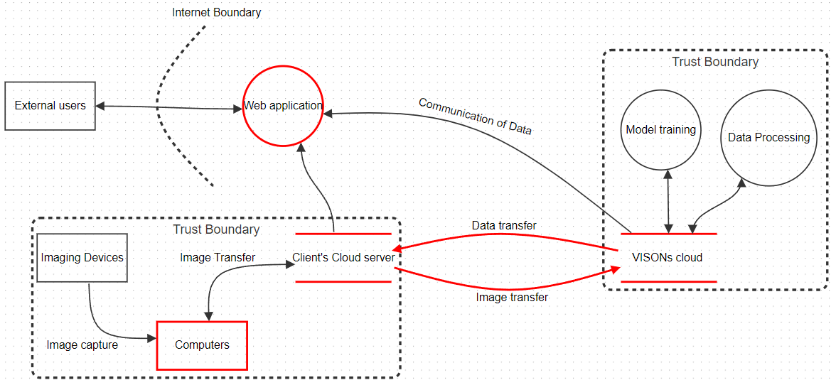
STRIDE MODEL

Slide 5
Risks and Mitigations
 | Threat | Mitigation
Computer and Web App | Spoofing by unauthorized access by attackers | Strong MFA, storing user credentials securely using encryptions and hasting techniques
Data Flow | Information Disclosure due to weak encryptions during transit | Use strong encryption (AES) both in rest and transit, virtual private VPNs
Client Cloud | Repudiation by clients denial of actions | Robust logging and auditing, digital signatures
VISIONs Cloud | Tampering by Model poisoning | Input validation, filtering mechanism to sanitize and validate incoming data inputs.

Slide 6

Third Party Risk
CSP
Risk : Potential data breaches or unauthorized access to VISION's cloud infrastructure
LIkelihood : 7
Impact : 9
OVerall risk Rating : High
Data Processing and storage services
RIsk : Risk of data integrity issues or non-compliance with data protection regulations
Likelihood: 6
Impact : 9
Overall Risk Rating : High

Slide 7
Third Party Risk cont’
Share Responsibility Model
Vision
Responsible for securing underlying infrastructure, including cloud environment, network, and physical facilities.
Ensures compliance with regulatory requirements, industry standards, and best practices.
Manages access controls, encryption, monitoring, and incident response within its environment.
Provides guidance, support, and collaboration opportunities to vendors for security enhancement.
Vendors
Responsible for securing their applications, data, and user access within the shared environment.
Required to adhere to VISION's security policies, standards, and contractual agreements.
Expected to implement robust security controls, encryption mechanisms, and access management practices.
Collaborate with VISION in vulnerability management, incident response, and security improvement initiatives.

Slide 8
Overall recommendations
Main process to focus
Data processing
Data communication
Confidentiality
Data leaks
Unauthorized access
Integrity
Tampering of client data and VISION data
Availability
Disrupting the distribution/access of information to clients and external parties
Decrease Business Operations

Slide 9
IRP
Preparation and Prevention
Conduct regular risk assessments tailored to VISION's infrastructure, applications, and data assets.
Detection and Analysis
Employ advanced security technologies such as SIEM systems, IDS, and EDR solutions to detect suspicious activity.
Containment
Swiftly isolate affected systems and networks to prevent further spread of security threats.
Foster close collaboration between VISION's incident response team and other internal teams to coordinate effective containment efforts.
Eradication
Conduct thorough forensic analysis to identify the root cause of security incidents and develop targeted remediation plans.
Recovery
Restore affected systems and data using comprehensive backup and recovery procedures tailored to VISION's critical assets.
Lessons Learned
Document best practices and recommendations specific to VISION's incident response process.
Foster collaboration among stakeholders to continuously enhance VISION's cyber resilience posture.

Slide 10
BCP
Backup Policies and Procedures
Nightly full backups with incremental backups every four hours during business hours.
Onsite storage for quick access and offsite replication for disaster recovery.
Data Retention and Archiving
Archives historical imaging data to secure cloud-based storage with versioning and retention controls.
Encrypts archived data and indexes for easy retrieval during audits or legal proceedings.
Backup Testing and Validation
Conducts monthly backup validation tests to verify integrity and completeness.
Recent test successfully restored customer database within designated RTO of two hours.
Recovery Point Objectives (RPOs) and Recovery Time Objectives (RTOs)
Defines one-hour RPO for critical patient data and four-hour RTO for essential imaging services.
Implements real-time replication and standby servers for rapid failover.
Data Encryption and Security
Encrypts all backup data using AES-256 encryption before transmission.
Access to backup repositories restricted to authorized personnel with RBAC and MFA.
Monitoring and Alerting
Deploys backup monitoring solution to continuously monitor backup jobs and storage utilization.
Triggers automated alerts via email and SMS in case of backup failures or storage capacity thresholds being exceeded.

Slide 11
Closing remarks
As members of the VISION team, we all have a role to play in ensuring the security and resilience of our systems and data. We commit to implementing the recommendations outlined in this presentation and working together to strengthen our cybersecurity defenses. By prioritizing cybersecurity and embracing a culture of security, we can protect our clients, uphold our reputation, and maintain our competitive edge in the market.
Thank you for your attention and engagement during this presentation. Should you have any further questions or require assistance with cybersecurity initiatives at VISION, please don't hesitate to reach out to our cybersecurity team.

